Slide 1
Walmart Trip Type Prediction

Slide 2
Problem Description
Predict Walmart Trip Type

Slide 3
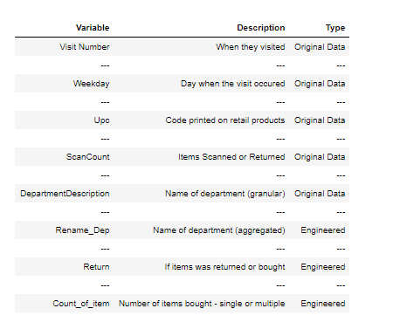
Variable Description
Feature Engineered variables:
Rename_Dep,Count_of_Item,
Return, PLU, COMMODITY
There are 37 trip types

Slide 4
Analysis
Predict Walmart Trip Type and determine which factors influence each TripType

Slide 5
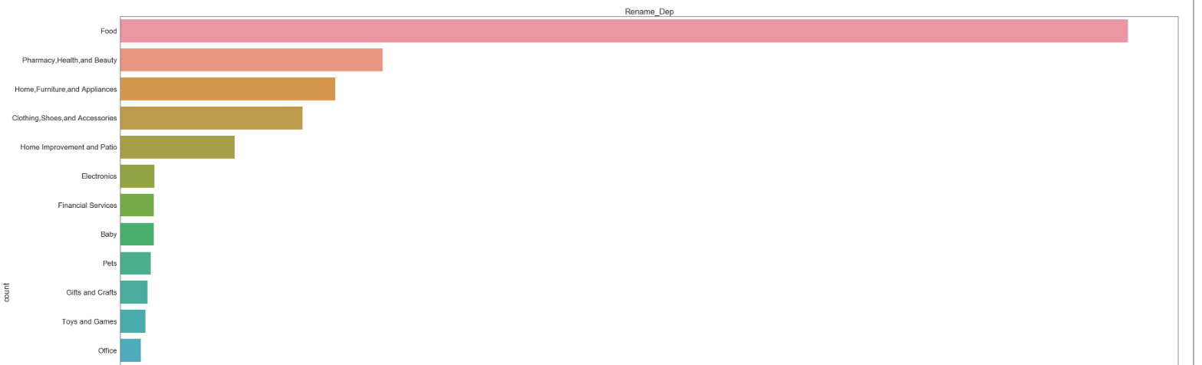
Insight – Aggregate Department
People mostly buy things from Food or Pharmacy related department

Slide 6
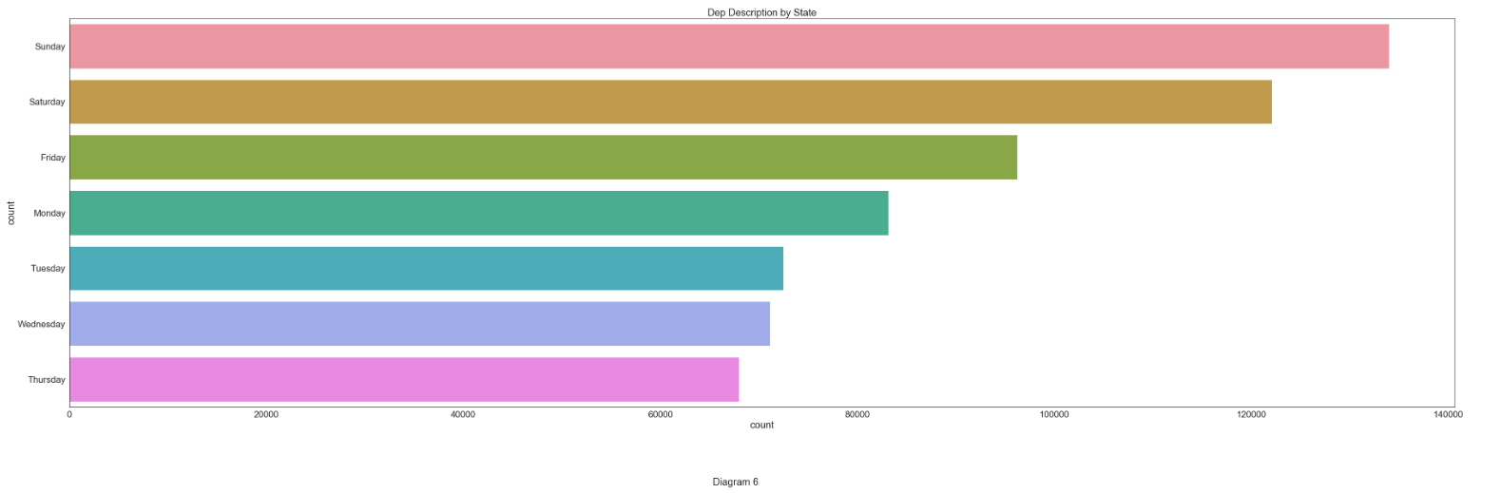
Insight – Day of Week
People are more likely to go shopping on Sunday, or Saturday (i.e. weekend)

Slide 7
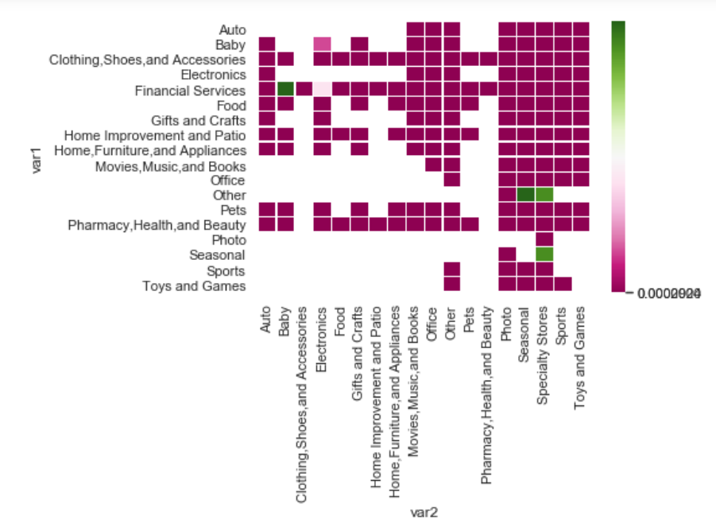
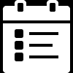
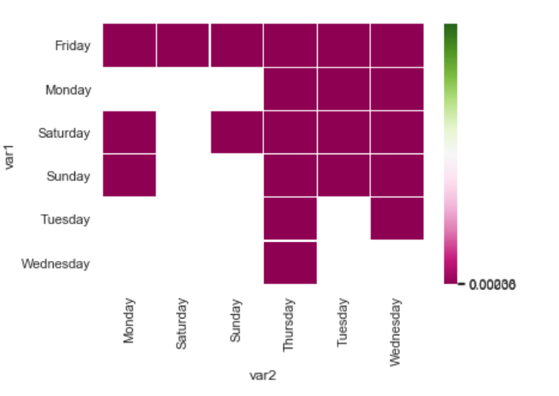
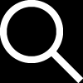
Statistical Testing
Using chi-square, to determine if there is significant difference with Bonferroni correction
Departments
Most of the department visits are significantly differently from one another
Some exceptions: Seasonal and Specialty stores, Other and Seasonal, and Other and Specialty Stores
YEAR
Weekday
Month date
Most weekdays are significantly different from each other
Thursday is significantly different across all other days, but that is not the case for Saturday and Sunday

Slide 8
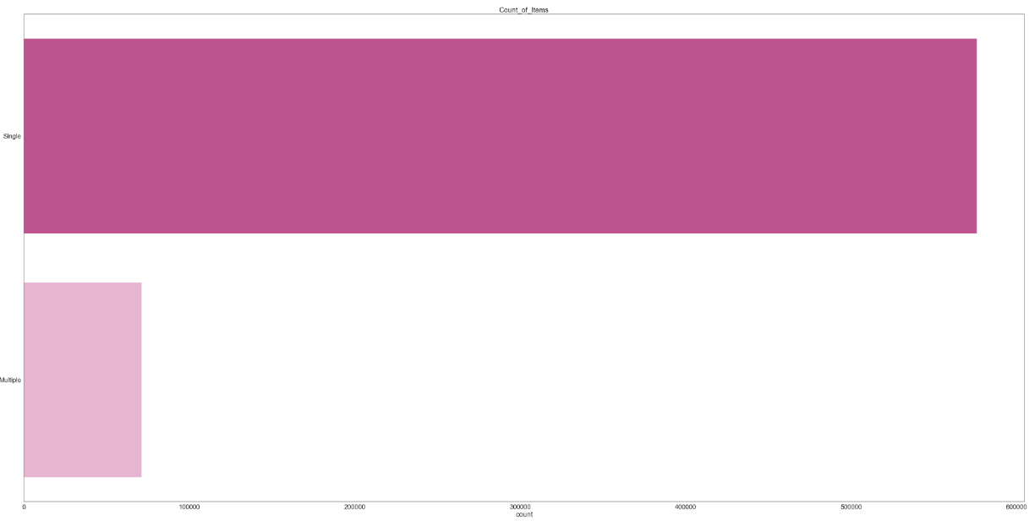
SINGLE
MULTIPLE
Insight – Number of Items Bought
Most of the people buy a one item

Slide 9
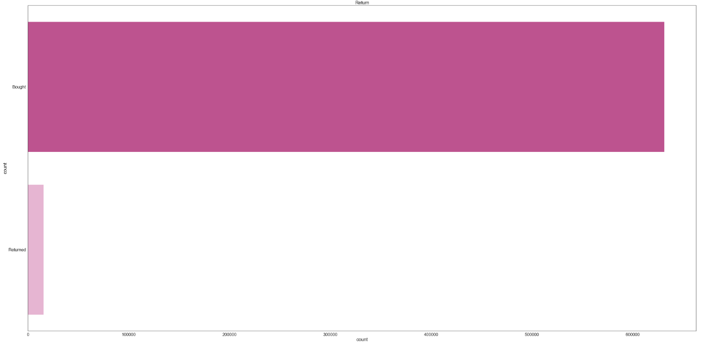
Insight – Returns
Few items are returned, most of them are bought.

Slide 10
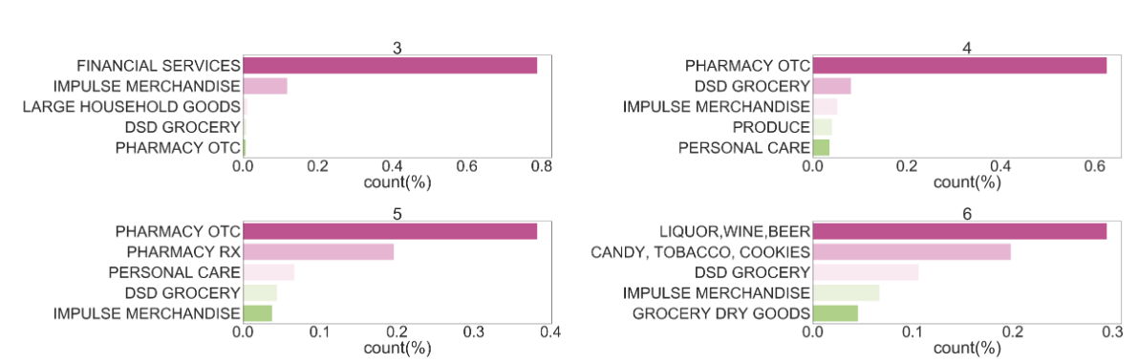
It seems like Department varies by Trip Type indicating that Department might be important factor contributing to predicting Trip Type

Slide 11
Modeling
Predict Walmart Trip Type

Slide 12
2 Models
79%
accuracy
21%
accuracy
Basic Neural Network
LSTM RNN
Single Layer Neural Network
1000 Neurons
L1 regularization
Early Stopping
Single Layer LSTM
600 Neurons
L1 Regularization
Early Stopping

Slide 13
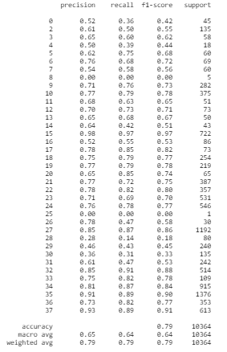
CLASSIFICATION REPORT
Classification Report shows that the recall and precision varies significantly for certain TripTypes
For Example, TripType 28 – 31 have lower F1-score compared to other TripTypes

Slide 14
Model Interpretability
Using Shap Values to explain the model by using sample of correctly classified rows

Slide 15
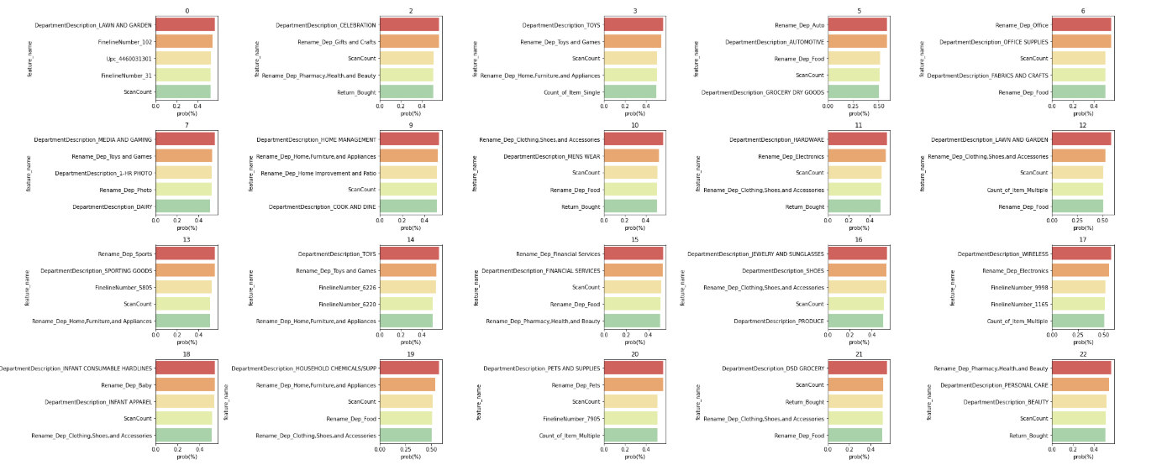
Insight – Aggregate Department
For the first 20 TripTypes, you can see the different features explain the model results. For example, for Trip Type 17, presence of Department being Wireless indicated that this trip type is related to electronic documents.

Slide 16
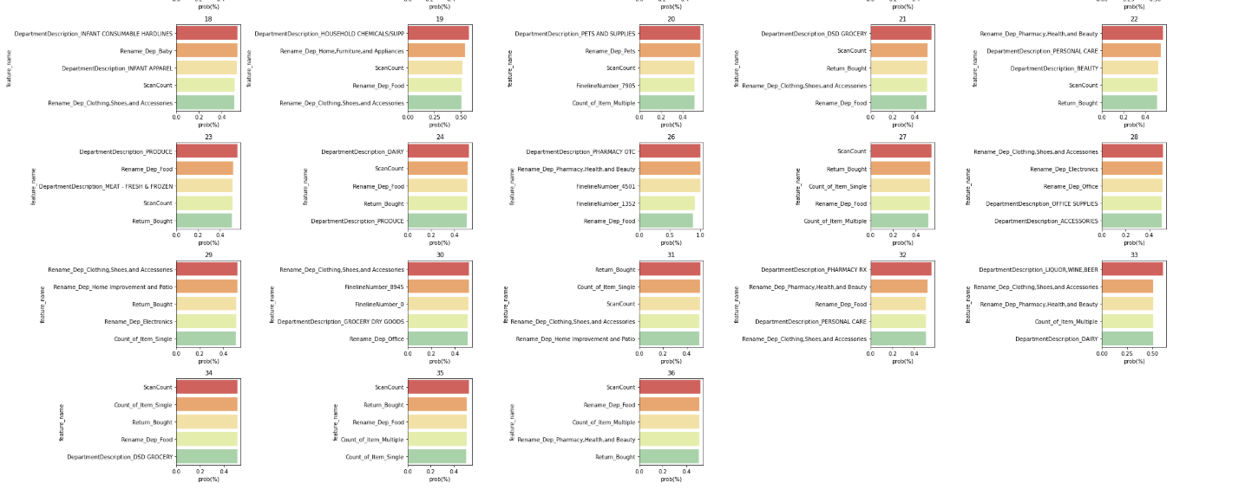
Insight – Aggregate Department
For TripType 18 to 36, we again find similar results. For Example, in TripType 35, Scan Count and Food Department are important predictors.

Slide 17
In Summary

Slide 18
Summary
Most of items are bought few returned, and for most items only a single item is bought
Items from Food and Pharmacy and Beauty Department are most frequently bought
People are most likely to buy during Friday to Sunday
Department, Weekday vary by TripType
Simple Neural Nets model outperformed RNN model (79% vs. 22% accuracy) but the recall, precision for some trip types are significantly lower

Slide 19
Next Steps
Use information from the model interpretability to test results from neural nets
For each trip type, look at the top features and create tests:
Example, Trip Type 2’s main prediction are going to the celebration and pharmacy/beauty department.
Walmart can a) put the two departments close by or b) create offers where you get each an item from each department for the price of 1
See if those type of discounts result in higher sales
Additionally they can use information to construct a loyalty program so that buying from one item, ends with consumers getting points which can be redeemed towards other items

